Slide 1
THE BATTLE OF NEIGHBORHOOD
Breaking down Median House Prices and School Ratings for Scarborough Canada for Immigrants

Slide 2
DESCRIPTION
Numerous individuals relocating to different conditions of Canada require the scan at a decent lodging cost just as great rating schools for their kids. The tasks expect to make an examination of highlights for an area as a relative investigation between neighborhoods. The highlights incorporate middle house cost and school evaluations and recreational offices. This would help individuals to get the consciousness of the spots before moving to another nation, state, city or spot for their work or to begin another life.
This Project would help individuals take a superior choice on picking the best neighborhood out of numerous areas in Scarborough city dependent on the dispersion of different offices in and around that area.

Slide 3
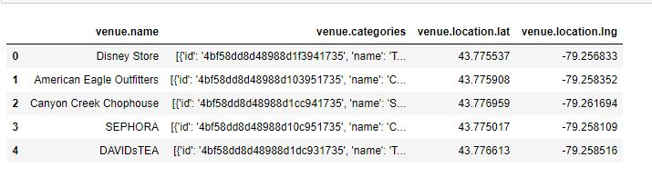
DATA REQUIRED
We will require geo-locational data about that particular district and the areas in that ward. It is "Scarborough" in Toronto.

Slide 4
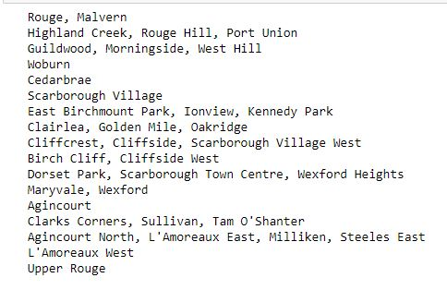
FOURSQUARE API
This venture would utilize Four-square API as its prime information gathering source as it has a database of a huge number of spots, particularly their places API which gives the capacity to perform area look, area sharing and insights regarding a business.

Slide 5
PROCESSING OF DATA
Handling the Retrieved Data and Creating a Data Frame for All the Venues inside the Scarborough.
At the point when the information is totally accumulated, we will perform handling on that crude information to locate our attractive highlights for every setting. Our principle include is the classification of that setting. After this stage, the segment "Scene's Category" will be One-hot encoded and diverse settings will have distinctive component segments.

Slide 6
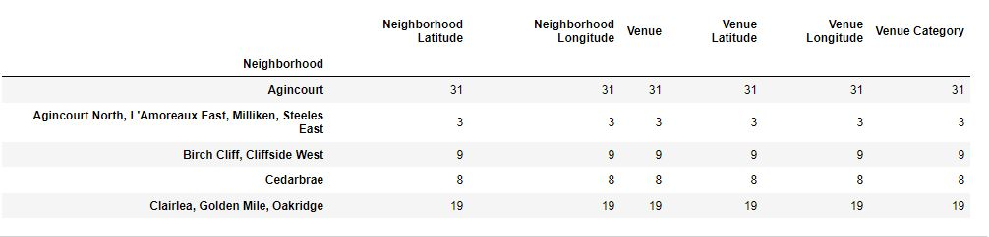
DATA FRAME CREATION

Slide 7
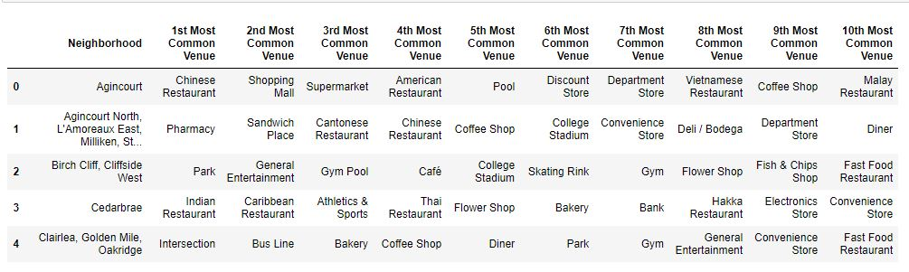
MOST COMMON VENUES

Slide 8
APPLYING k-means CLUSTERING
Scarborough_grouped_clustering = Scarborough_grouped.drop('Neighborhood', 1)
kmeans = KMeans(n_clusters=3, random_state=0).fit(Scarborough_grouped_clustering)
kmeans.labels_
Scarborough_merged =df.iloc[:16,:]
Scarborough_merged['Cluster Labels'] = kmeans.labels_
Scarborough_merged = Scarborough_merged.join(neighborhoods_venues_sorted.set_index('Neighborhood'), on='Neighborhood')
Scarborough_merged.head()

Slide 9
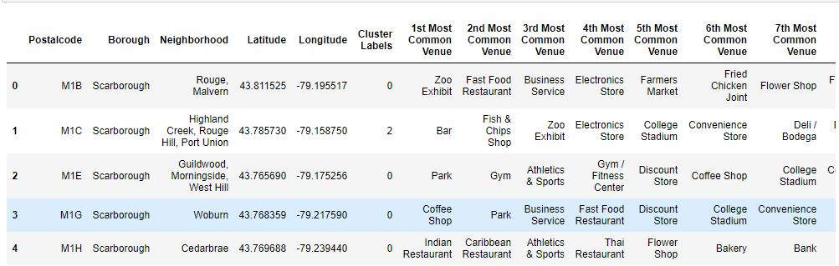

Slide 10
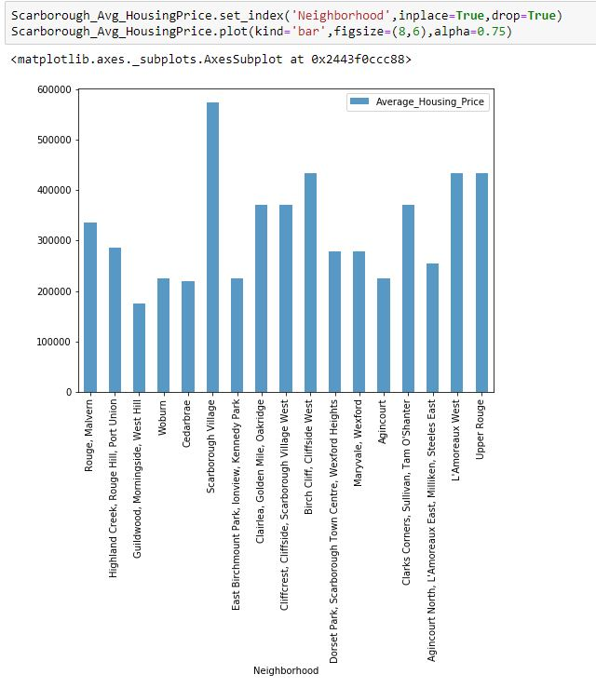
NEIGHBORHOOD HOUSING PRICES

Slide 11
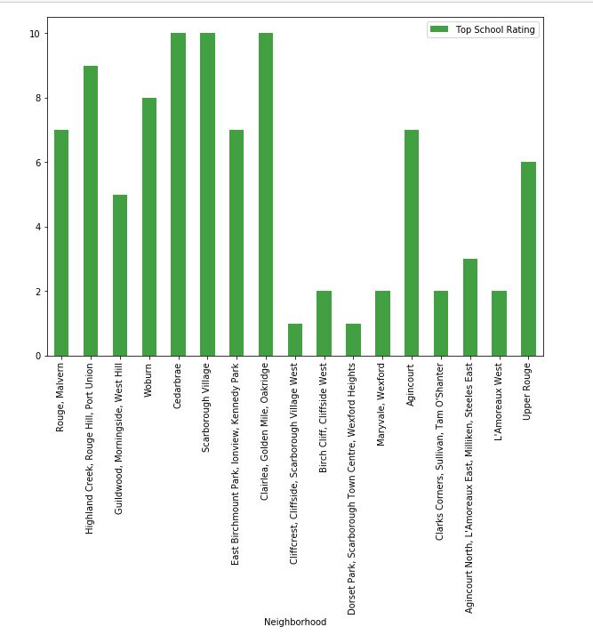
NEIGHBORHOOD SCHOOL RATINGS

Slide 12
CONCLUSION
In this task, through a k-implies group calculation, we separate the area into 03 bunches, which have comparable neighborhoods around them. Utilizing the outlines above choice wanting to a specific neighborhood dependent all things considered house costs and school rating can be made.
--THANKS--

